Slide 1
The Maverick Ice Cream Emporium
Created by:
Diego Gonzalez
Chelsea May
Jonathan El-Khoury

Slide 2

Slogan(s)
MICE: Masterful Ice Cream Everyday!
Ice cream made easy. We don’t horse around!
Mavs Ice Cream. It’s bucking good!

Slide 3
History of Ice Cream
A man once said that an ice cream a day keeps the doctor away (or something like that).
Ice cream has a long and storied history dating back to Ancient Greece. Heck, Hippocrates even recommended it to his patients “as it livens the life-juices and increases the well-being.”
Do you really need anymore convincing to have ice cream?
https://en.wikipedia.org/wiki/Ice_cream

Slide 4
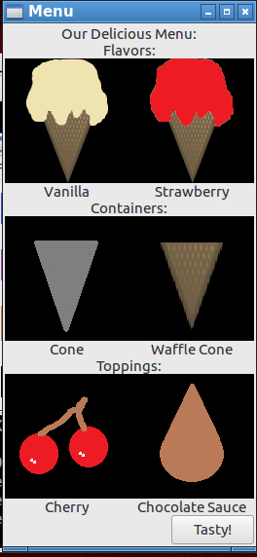
What Does Our App Offer!?
More like what doesn’t this app offer?
It won’t do your laundry for you.
It won’t have a conversation with you.
It won’t tuck you in, sadly.
Our app offers the comprehensive ability to create new items (and add pictures!), hire employees, take orders, and manage multiple emporium locations!
The ability to manage stock on the fly!
Add pictures at your leisure!

Slide 5
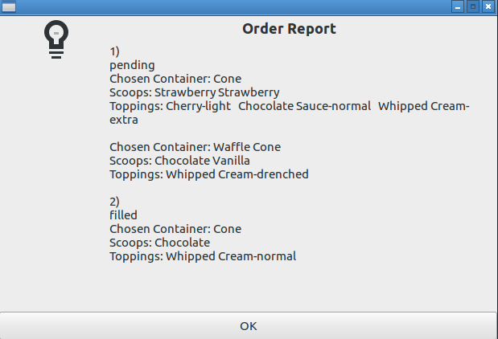
Comprehensive Order Report!

Slide 6
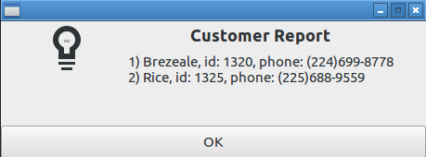
Keep Track of your Customers!

Slide 7
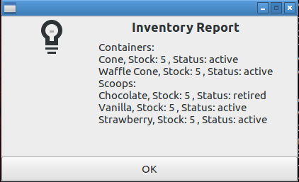
Keep Track of Your Inventory on the Fly!

Slide 8
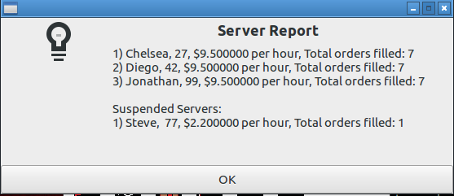
Keep track of all your Servers and their data!

Slide 9
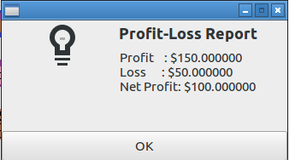
Look at How Much Money You’ve Made! (And I guess how much money you’ve spent but that’s less important)

Slide 10
Contact Us!
Email: mice_team@rats.com
Phone: (817) 555 – 6433 / (817) 555 – MICE
Customer Support: steve@mice.com

